Slide 1
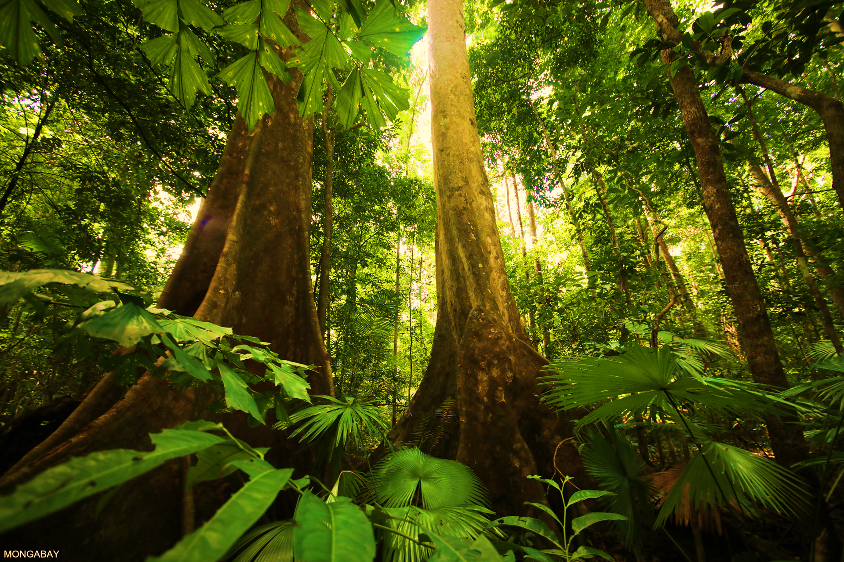

Rain Tree
9

Slide 2
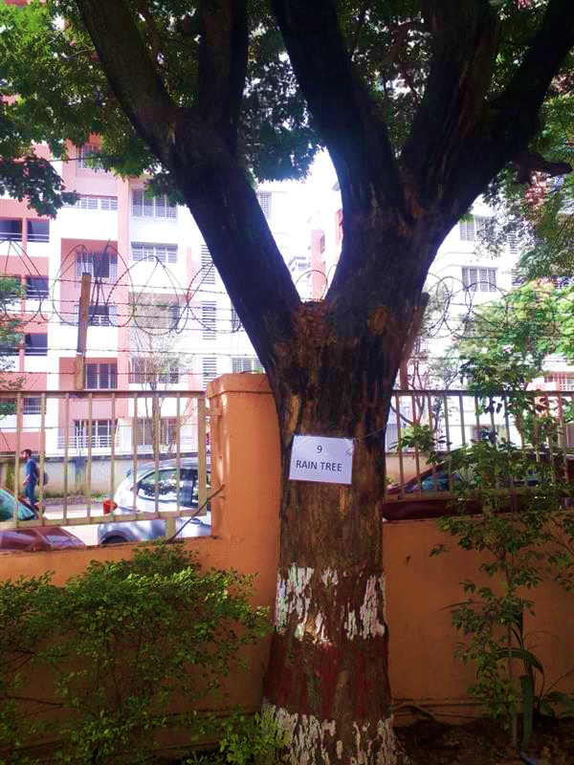
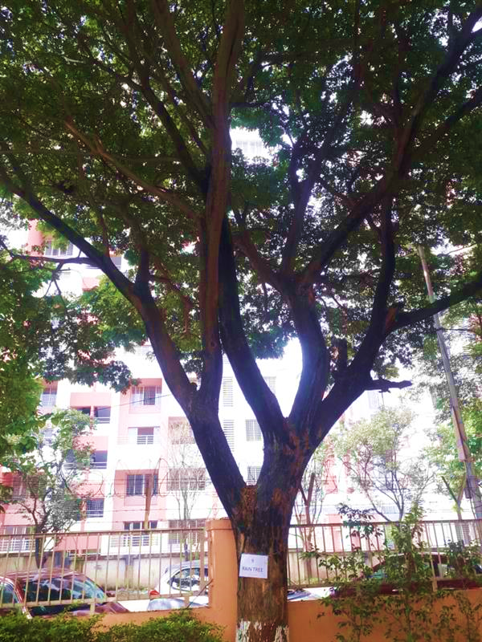
In between Gate no.1 and Gate no.2
Rain Tree

Slide 3
Common name: Rain Tree or Monkey Pod Tree
Scientific Name: Samanea saman
Family: Fabaceae or Leguminosae
Habit: 'Rain Tree' alludes to tree's habit of folding up leaves before rain, or to the shower of secretions from sap-sucking Cicadas resting on tree. Saman is a wide-canopied tree with a large symmetrical umbrella-shaped crown. It usually reaches a height of 15–25 m (49–82 ft) and a diameter of 30 m.
Distribution: Its range extends from Mexico south to Peru and Brazil, but it has been widely introduced to South and Southeast Asia, as well as the Pacific Islands, including Hawaii.

Slide 4
Description :
Its branches have velvety and hairy bark. Large branches of the tree tend to break off, particularly during rainstorms. This can be hazardous as the tree is very commonly used for avenue plantation.
A rain tree leaf is pinnate made of 6–16 leaflets, each leaflet is shaped like a diamond 2–4 centimetres long and 1–2 centimetres wide with a dull top surface and finely hairy beneath. The tree sheds its leaves for a while during dry periods. Its crown is big and can provide shade but allows rain to fall through into the ground beneath it.

Slide 5
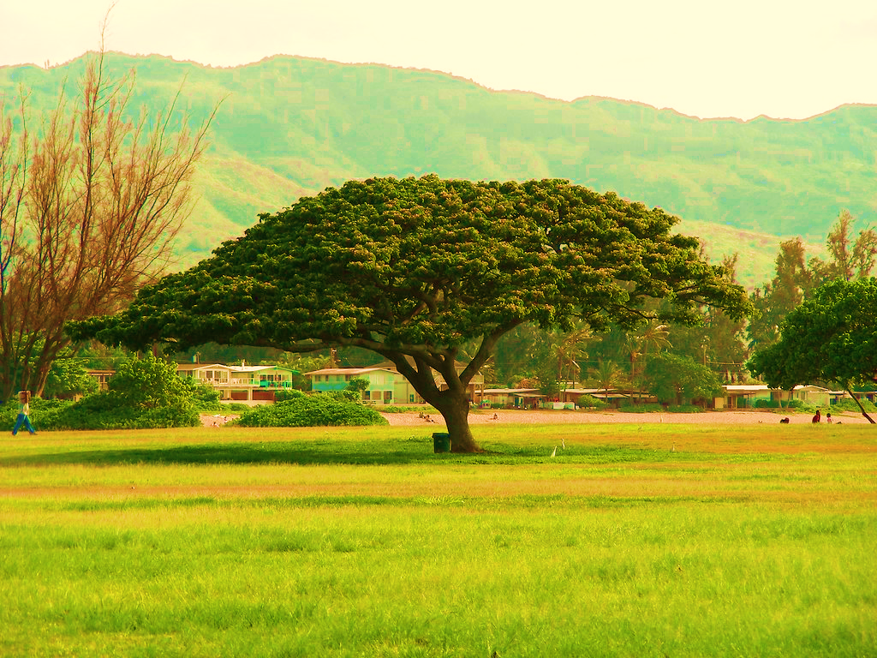
Uses
The edible fruit pulp can be made into a beverage that tastes like lemons; the pulp is also an additive to gasoline.
Its wood is used for carving and making furniture.
The "Samanea saman" tree is one of several types of host plants that allows lac insects (Kerria lacca) infestation. The resultant copious sap/insect discharge caused by this insect is a harden material that is subsequently collected and processed into lac/shellac and used in making lacquerware and wood finishes.

Slide 6
Uses :
The edible fruit pulp can be made into a beverage that tastes like lemons; the pulp is also an additive to gasoline.
Its wood is used for carving and making furniture.
The "Samanea saman" tree is one of several types of host plants that allows lac insects (Kerria lacca) infestation. The resultant copious sap/insect discharge caused by this insect is a harden material that is subsequently collected and processed into lac/shellac and used in making lacquerware and wood finishes.
Due to its dense canopy, rain tree is planted in plantations as shade tree for coffee, cacao, and other crops.
Medicinally, the plant is used in the treatment of diarrhoea, stomach pain, and sore throat. It is also used as a laxative. The pods can be eaten, and the pulp can be made into drink.

Slide 7
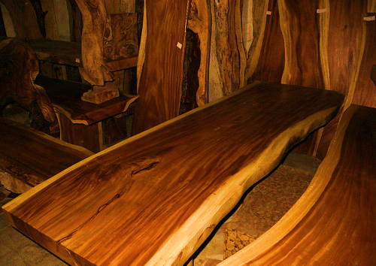
Uses
Due to its dense canopy, rain tree is planted in plantations as shade tree for coffee, cacao, and other crops.
Medicinally, the plant is used in the treatment of diarrhea, stomach pain, and sore throat. It is also used as a laxative. The pods can be eaten, and the pulp can be made into drink.

